Slide 1
Workforce distribution using Demand-Supply Heat Map
Team 7: Throttling Error
Notes:
Trying to exploit the demand supply gap currently existant in the delivery management system

Slide 2
Why?
Improved customer satisfaction
Decrease latency by better distribution of workforce
Better experience for the workforce, Increased incentive opportunity

Slide 3
Demo

Slide 4
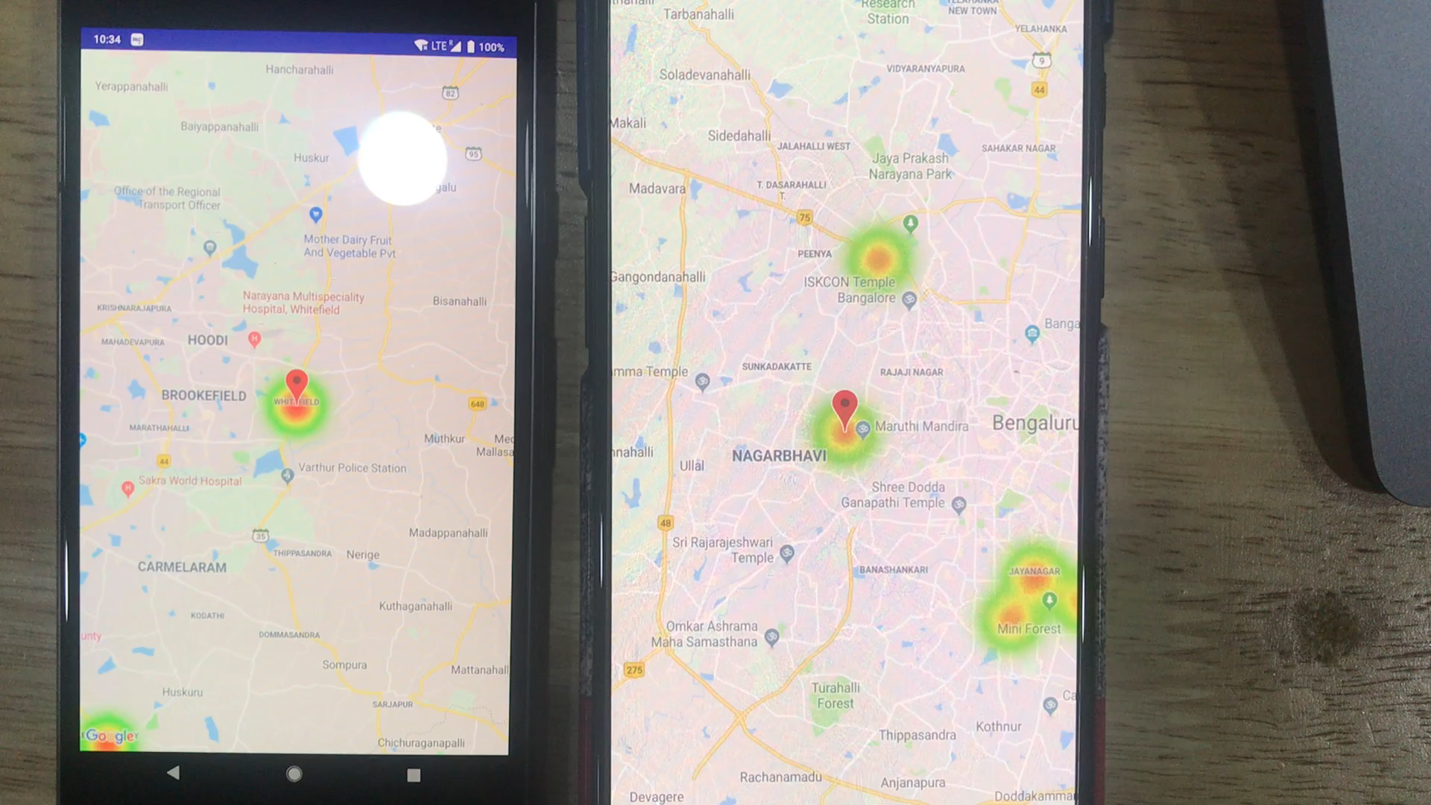

Slide 5
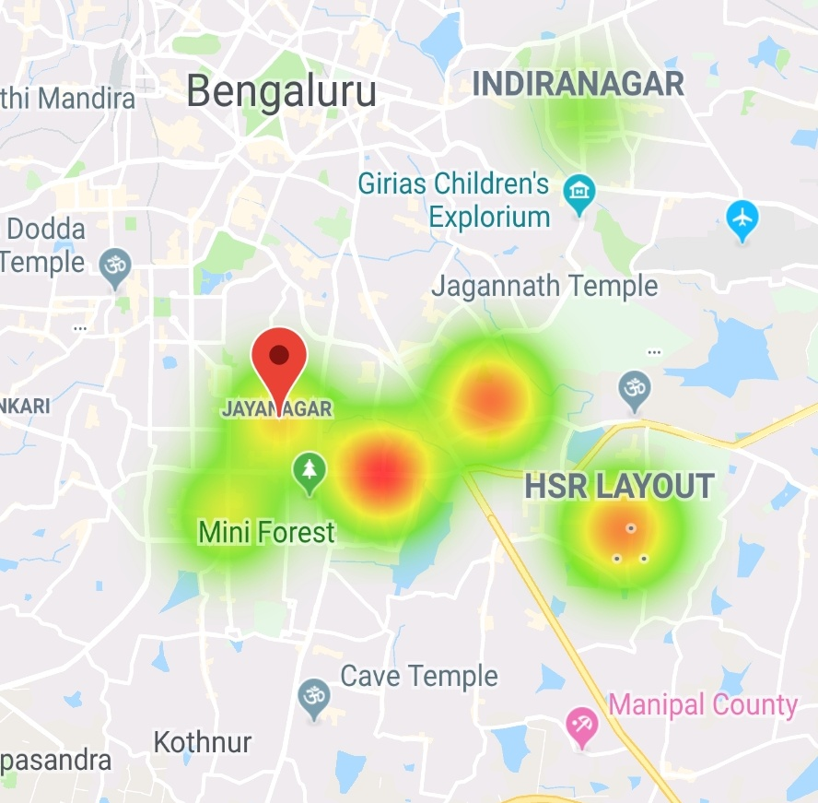
What?
Workforce Client
The resource client gets a heat map of the next
“# of predicted orders/ # of resources available”
in that area
Resource makes an informed decision, based on heat map (can still retain his/her location specifics)
Updating the heat map based on the decision taken

Slide 6

How? – The technical aspects

Slide 7
Trained
Model
Workforce
APIs
Database
Client
Server

Slide 8
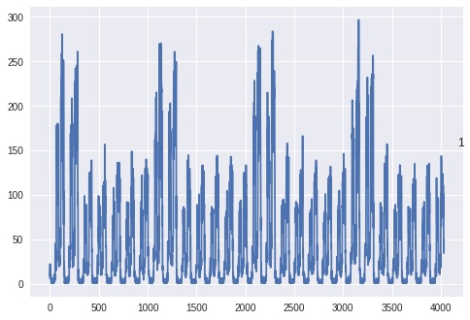
Synthetic Data distribution over 1 month

Slide 9
Machine Learning Model Architecture
Y1_{t}
Y2_{t}
Y3_{t}
Y8_{t}
Y9_{t}
Y10_{t}
X1_{t+10}
X2_{t+10}
X3_{t+10}
X8_{t+10}
X9_{t+10}
X10_{t+10}
LSTM
LSTM
LSTM
LSTM
LSTM
LSTM
X1_{t}
X2_{t}
X3_{t}
X8_{t}
X9_{t}
X10_{t}

Slide 10
Future Scope
We are currently reliant on the manual decisions of the resources for keeping their experience optimal. Once we grow more confident with the model, we can aim for better efficiency by providing active guidance.
Concurrently predicting possible drop in the intensity of the hotspots considering time taken to reach there.
Predicting drivers movement on the go to reduce sudden mass movement into higher intensity areas
Adding correlation between different blocks in the model architecture

Slide 11
Thank You

